Slide 1
Sales Data Analysis
By
Supriya Y

Slide 2
Agenda
Agenda
Identifying best buyers and right kind of products from sales data by analyzing and predicting trends.

Slide 3
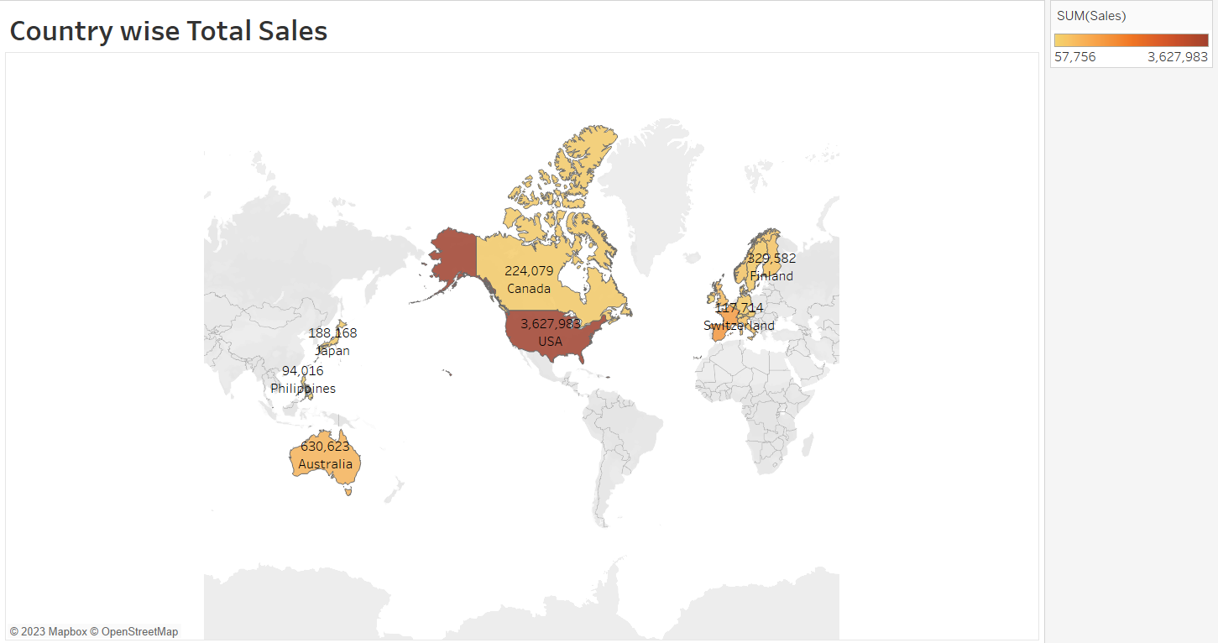
Choropleth map

Slide 4
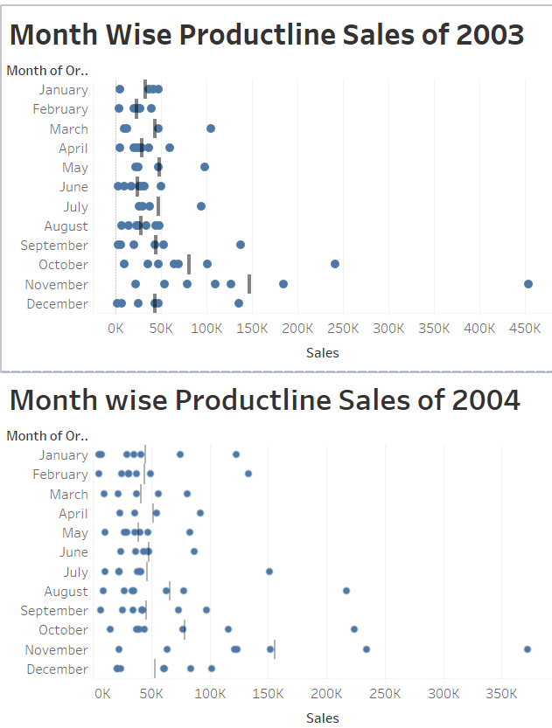
Dot Strip Chart

Slide 5
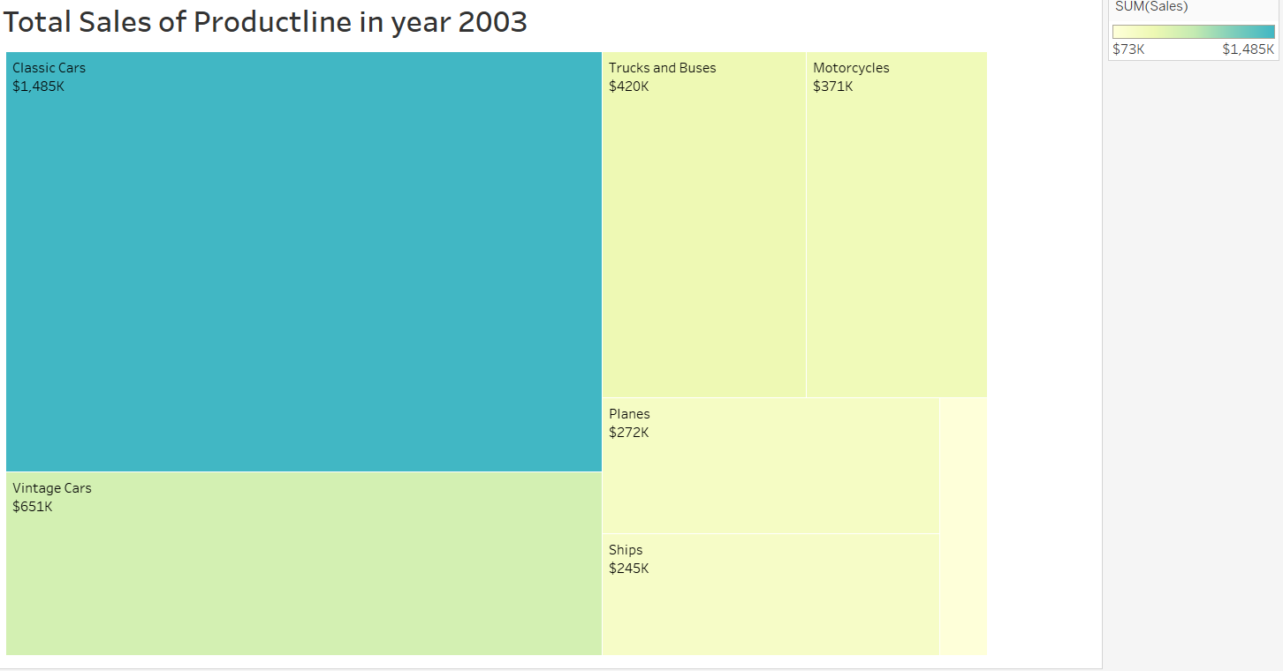
Tree Map

Slide 6
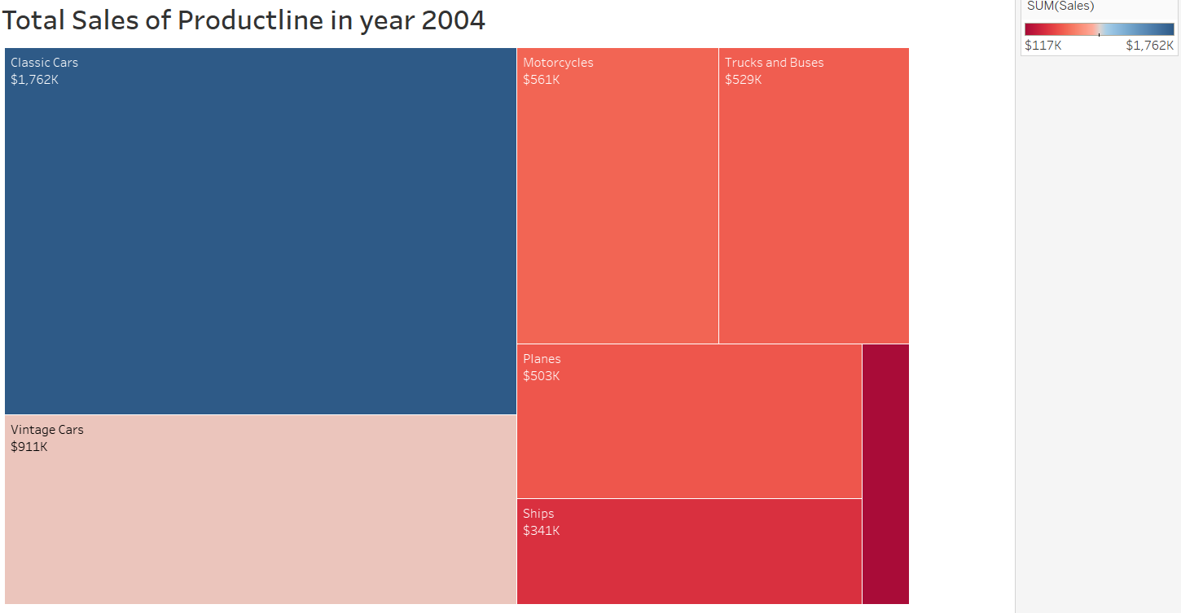
Cont..

Slide 7
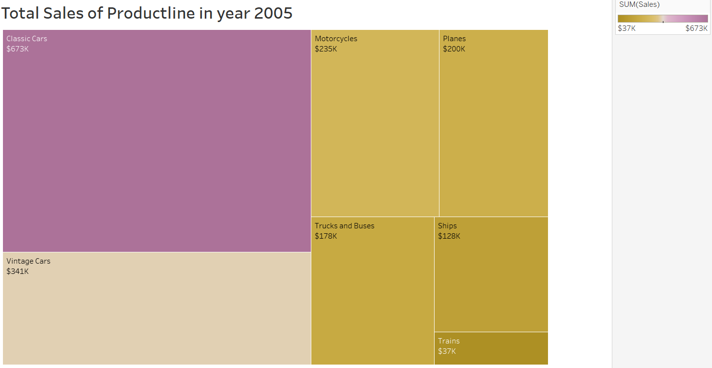
Cont..

Slide 8
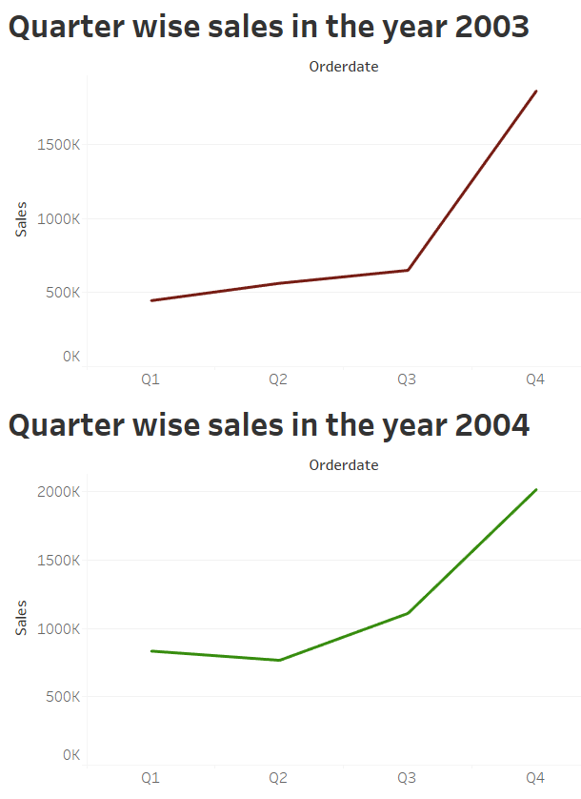
Line Chart

Slide 9
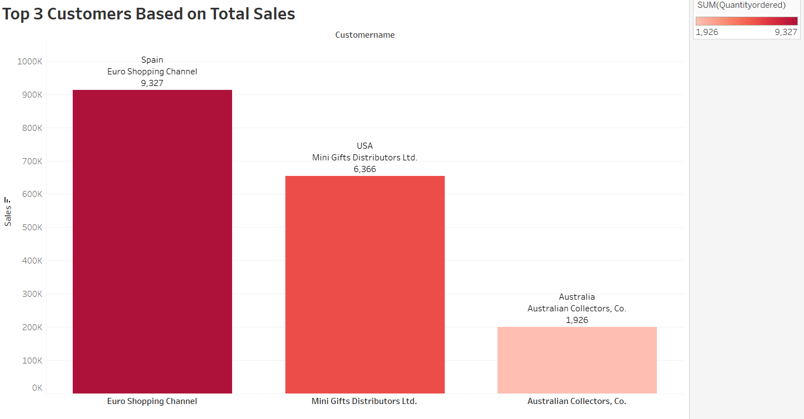
Bar Graph

Slide 10
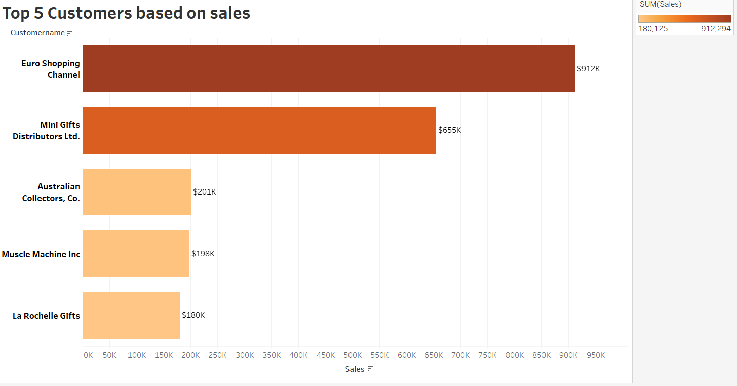

Slide 11
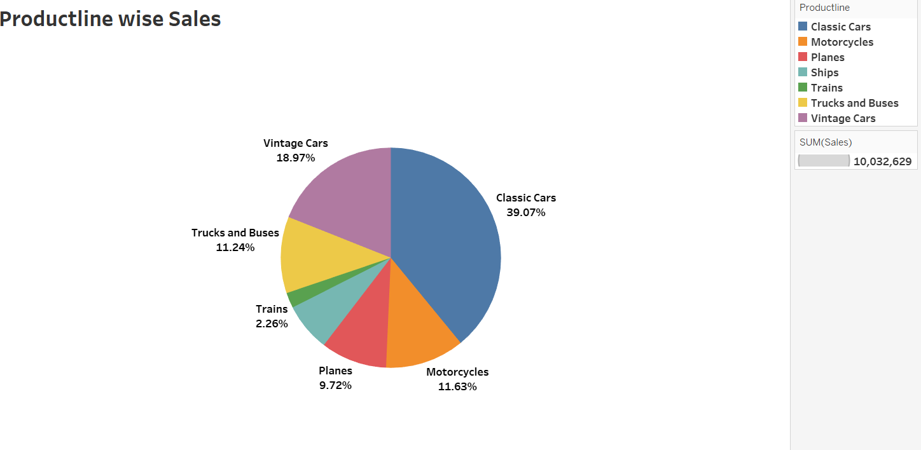

Slide 12
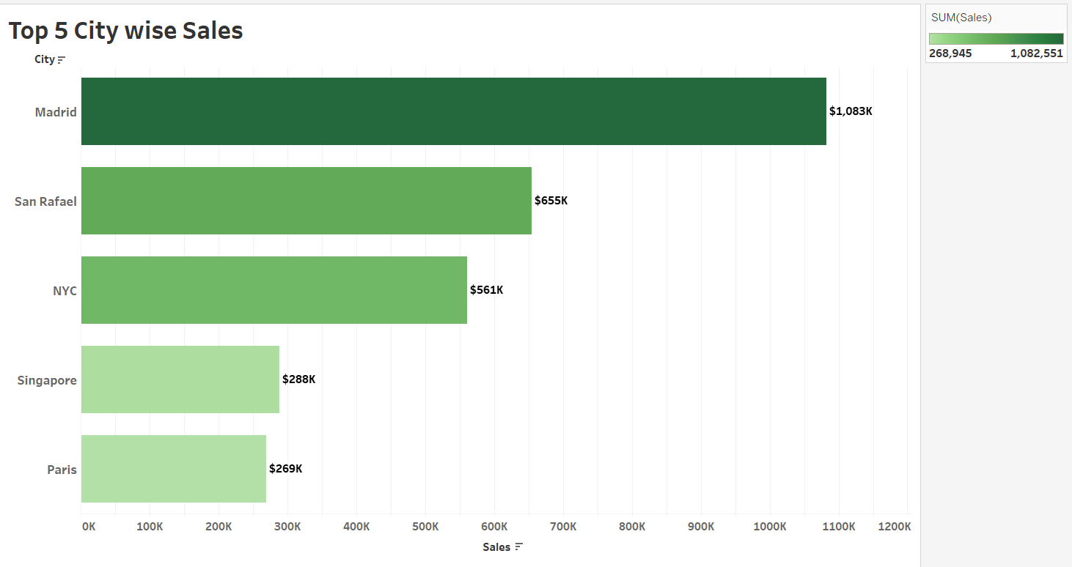

Slide 13
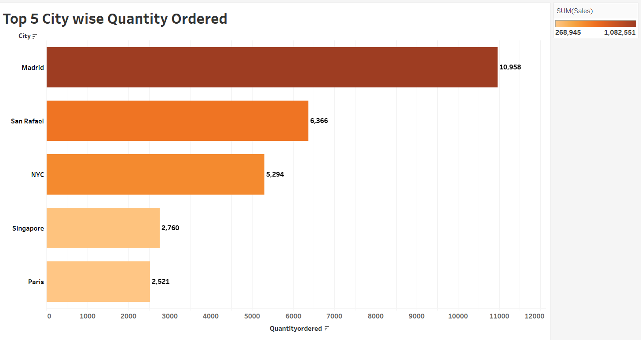

Slide 14
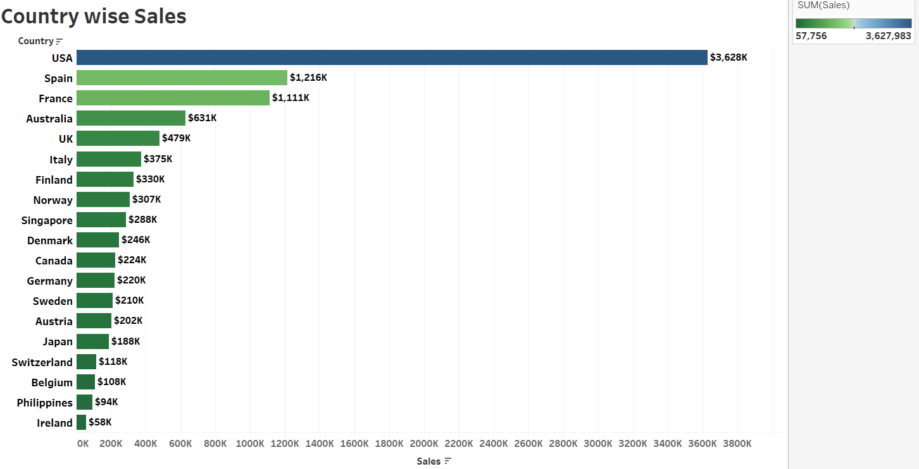

Slide 15
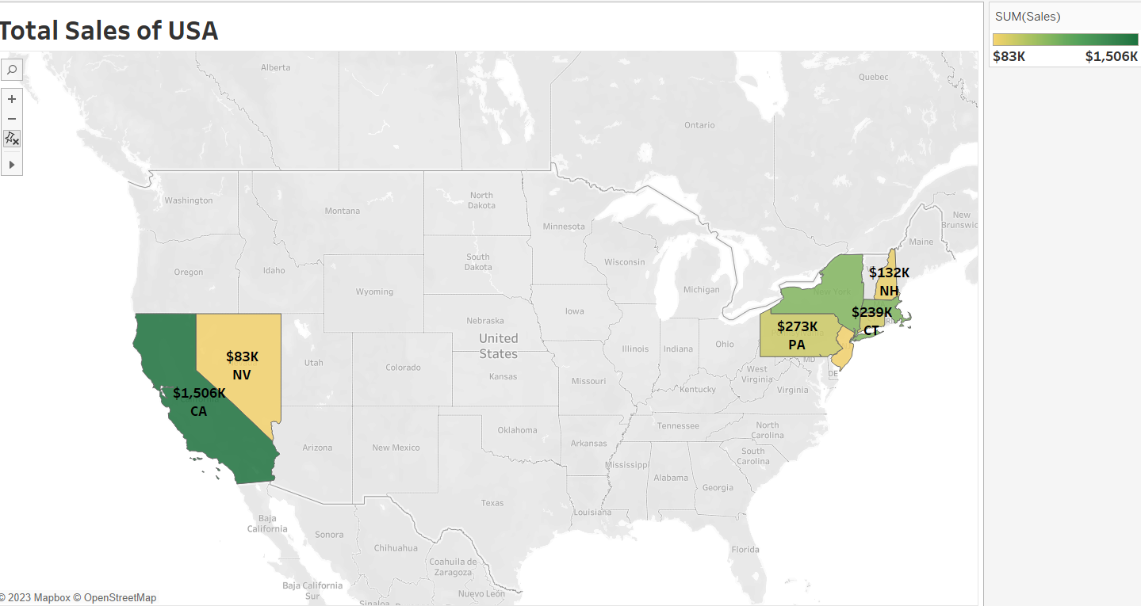

Slide 16
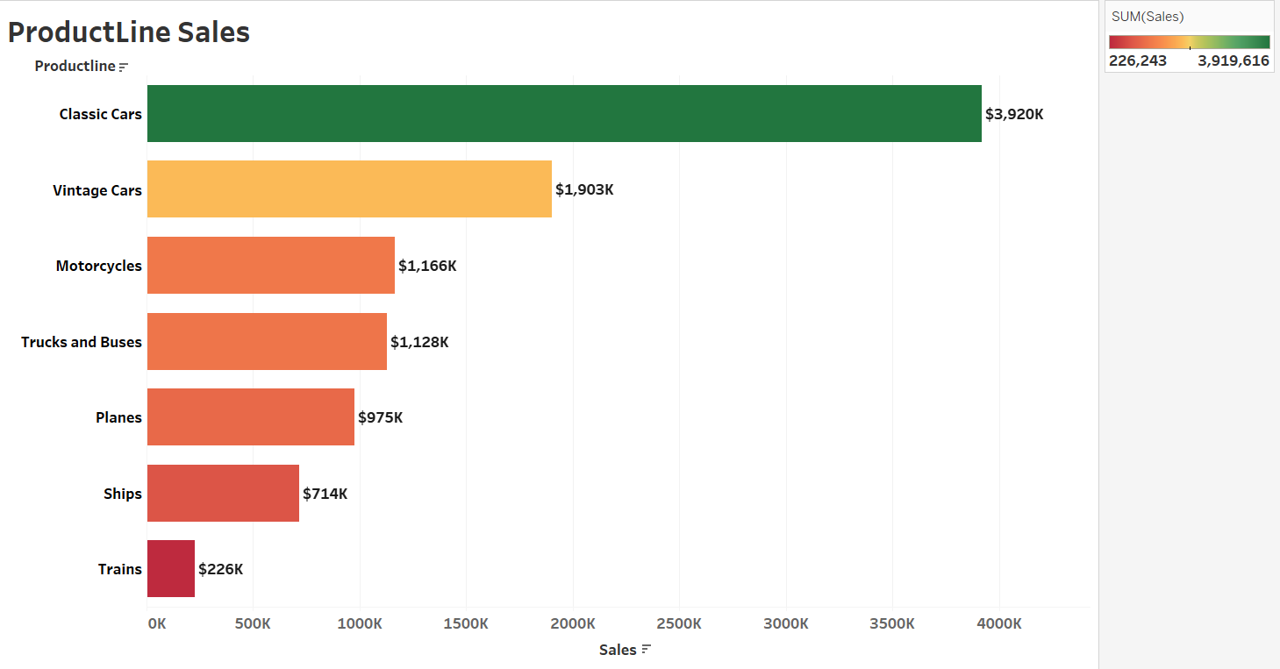

Slide 17
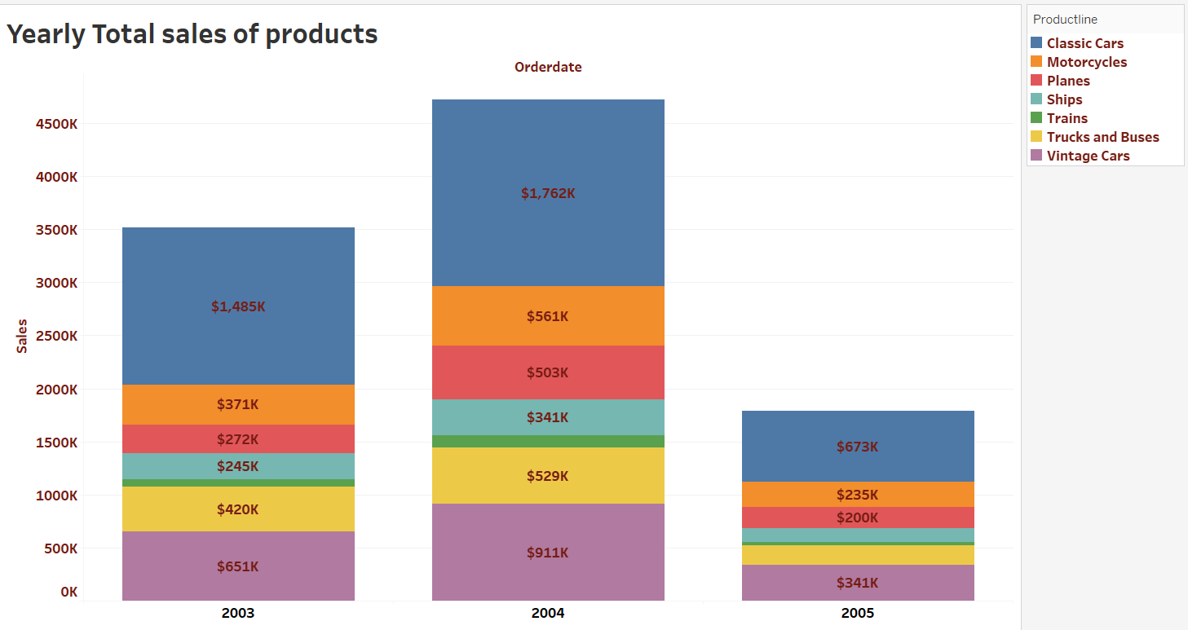

Slide 18
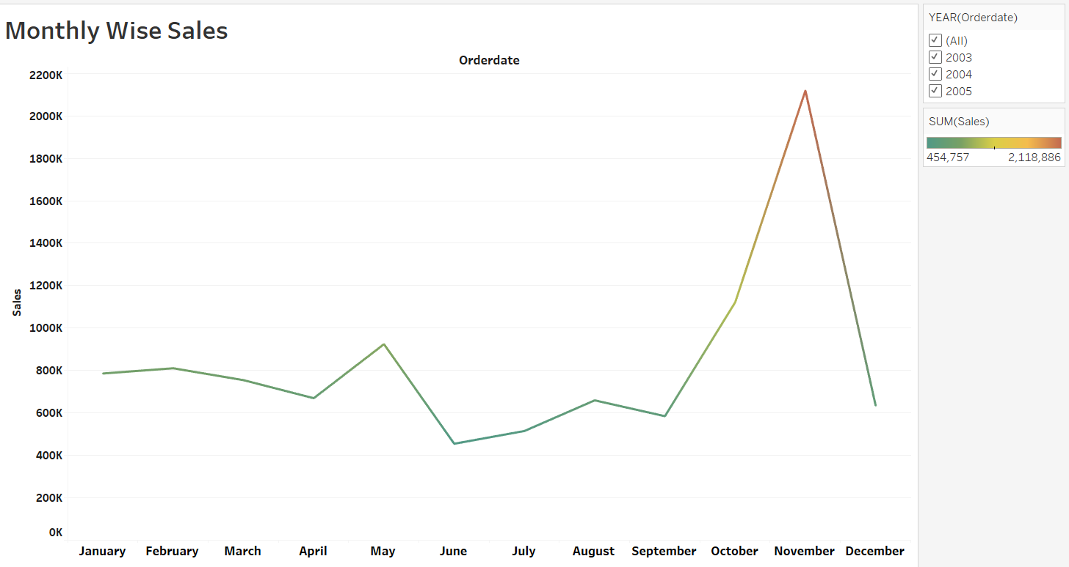

Slide 19
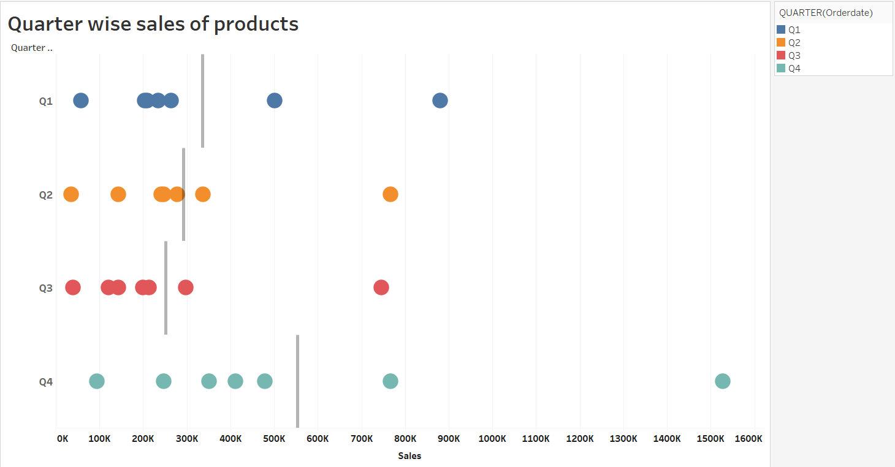

Slide 20
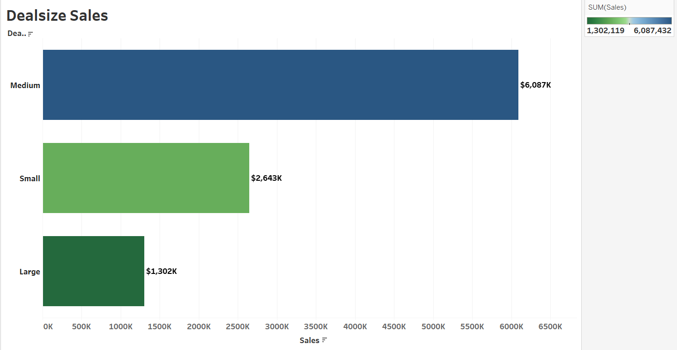

Slide 21
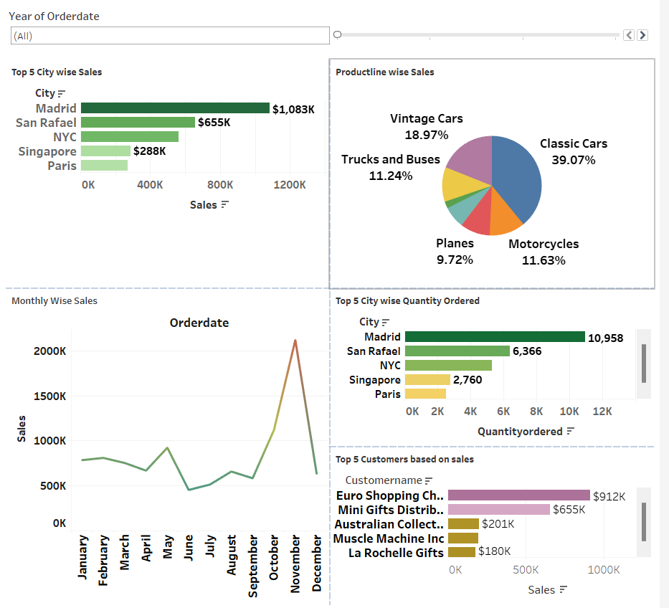
Dashboard

Slide 22


Conclusion
From the above graphs the USA has highest sales.
In USA ,CA state has highest sales.
November month has highest sales.
Classic cars are having highest sales in all the years.
In the fourth Quarter the sales values has increased more.
The top customer is Euro Shopping channel with highest sales.
Madrid city has highest quantity ordered and also highest sales.
Medium Deal size has highest sales.

Slide 23
Thank you

